Slide 1

ACSE-4 Project 4 KUZUSHIJI-MNIST CLASSIFIER
Team Softmax
Richard Boyne
Mattia Guerri
Jiaye Mao
Notes:
ugikjbkjbgkjbgiujb

Slide 2
1. Data Pre-Processing & Augmentation
2. Training Approach
3. Validation Approach
4. Network Architecture
LeNet5
AlexNet5
AlexNet7
5. Hyper-Parameter Tuning
6. Results

Slide 3
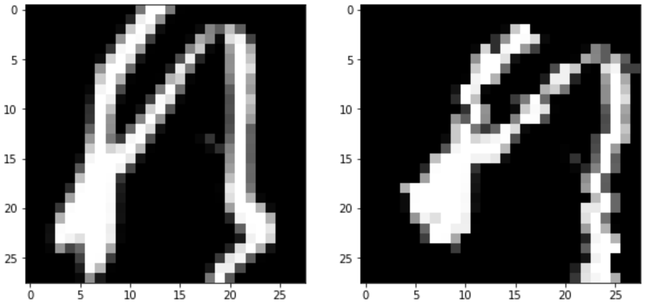
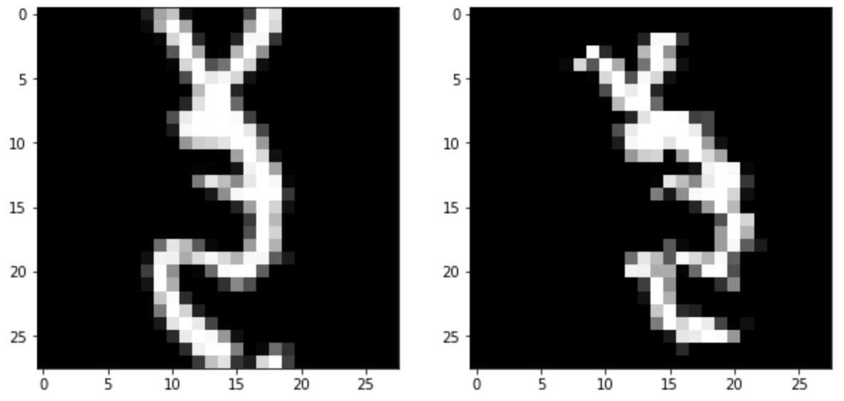
Data Pre-Processing & Augmentation
RandomCrop
RandomRotation
Affine
ColorJitter
Figure 1 : Example of full augmentation
Figure 2 : Example of full augmentation

Slide 4
Training Approach
Dropout
Implemented on last two linear layers
Batch Normalization
Implemented on first two convolutional layers

Slide 5
Training Approach
Loss Function & Final Activation
Optimizer
prediction disagreements between SGD and Adam training was between 0.6%−1.6%

Slide 6
Validation Approach
Ratio of 9:1 in training set and validation set
K-fold validation
Only two of the ten possible k folds were trained

Slide 7
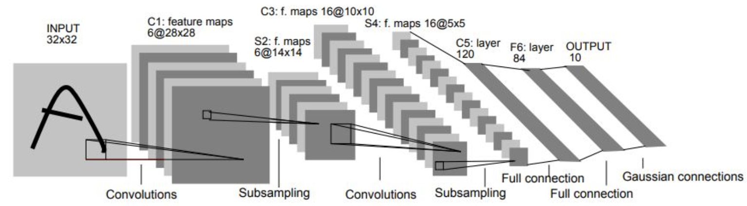
LeNet5
Figure 3 : LeNet 5 Structure
Two sets of convolutional and average pooling layers
Two fully-connected layers and finally a softmax classifier
62,000 parameters

Slide 8
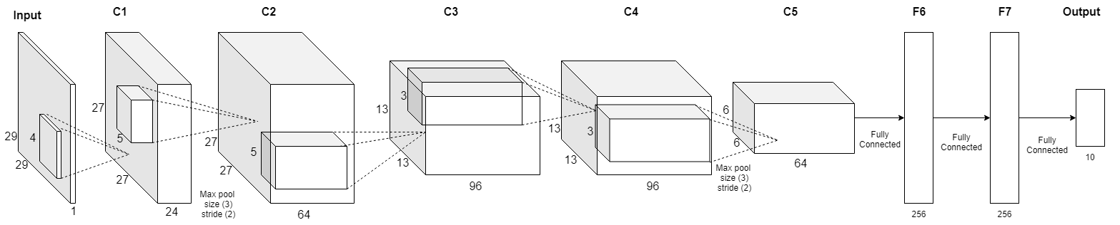
Reduced AlexNet(AlexNet5)
Figure 4 : AlexNet 5 Structure
change the size and depth on the input convolutional layers
decrease the number of neurons in the output fully connected layers
reduce the number of channels and fully connected neurons
1 million parameters

Slide 9
Reduced AlexNet(AlexNet7)
Figure 5 : AlexNet 5 Structure
Two additional layers
512 neurons
Two additional convolutional layers between C1 and C2
increased the first fully connected layer to 512 neurons
1.9 million parameters

Slide 10
Hyper-Parameter Tuning
Optimizer | Learning rate | momentum | Weight decay
SGD | 5E-3 | 0.8 | 1E-4
Adam | 1E-4 | - | -
Table 1 : Best parameters after tuning
Overall validation increase of 0.2%

Slide 11
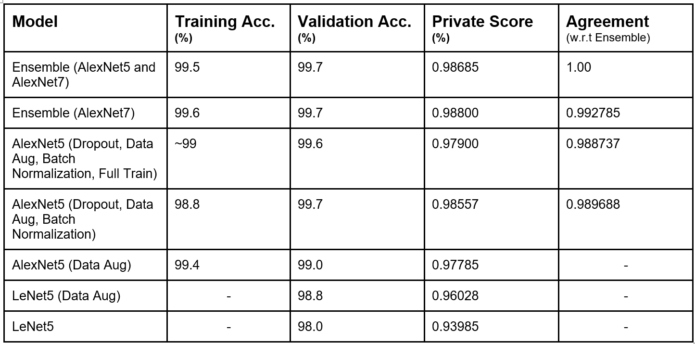
Results
Table 2 : Results on Kaggle leaderboard

Slide 12
Best Result one
Ensemble of four models:
Model | Optimizer | Validation set accuracy
AlexNet5 | SGD | 0.997
AlexNet5 | Adam | 0.997
AlexNet7 | SGD | 0.997
AlexNet7 | Adam | 0.997
Table 3 : Models ensembled in best result one
Test set accuracy : 0.98685

Slide 13
Best Result two
Ensemble of two models:
Model | Optimizer | Iterations | Training set accuracy | Validation set accuracy
AlexNet7 | SGD | 175 | 0.995 | 0.997
AlexNet7 | Adam | 200 | 0.997 | 0.997
Table 4 : Models ensembled in best result two
Test set accuracy : 0.988

Slide 14
Honourable mentions
LeNet6
AlexNet6_wide
AlexNet10 (10 convolutional layers)
validation accuracy 0.997
Image inflation
After first training, add those failed images additionally into training set and train it again.
Transfer learning on pre-trained AlexNet
Duplicate the channel of dataset
Set the last layer output from 1000 to 10
Augmentation Estimation

Slide 15
QUESTIONS

